Slide 1

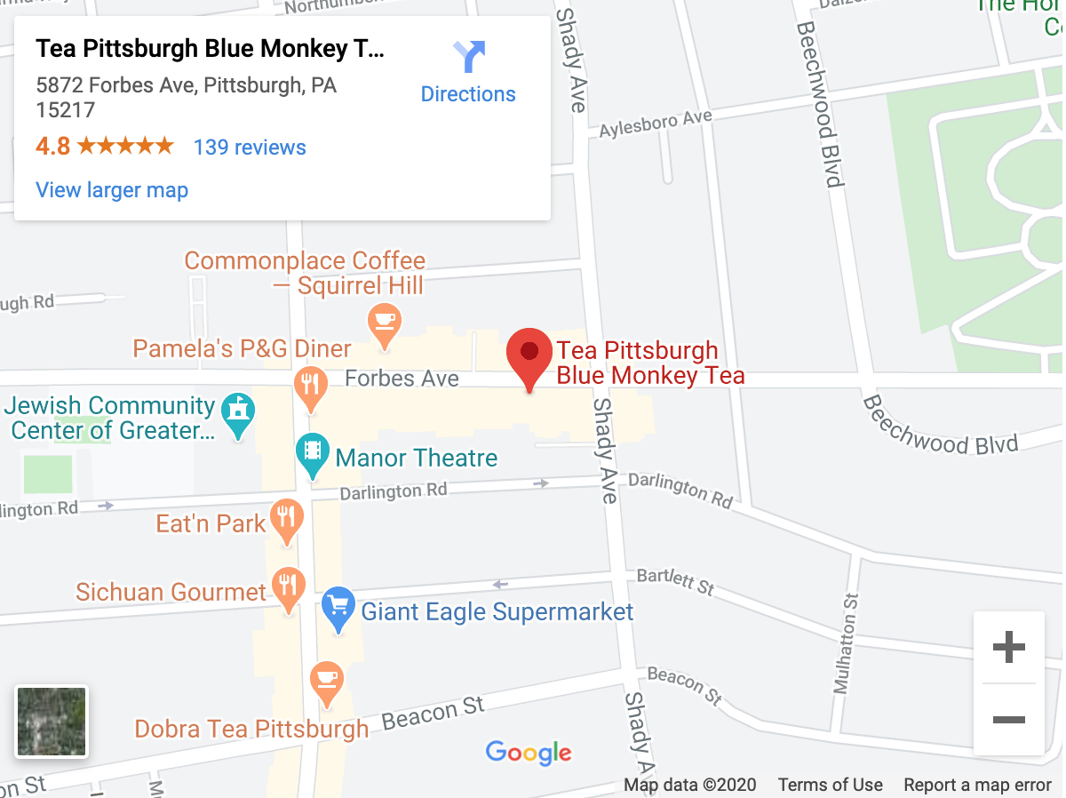
Logo is clickable to bring you back to the home page
Also clickable to bring user to other pages
Home
Products
Store Information
Contact Us!
Purpose, give customers a bit of background on the shop
Welcome
The original store was established in May of 2002. It was named Wicks & Beans, as the original merchandise consisted mostly of scented candles and coffee beans. We were located at 2207 Murray Ave, also in Squirrel Hill (down and across from Mineo's Pizza.) Since then we've become mostly a Tea Specialty store with over 400 varieties of teas in stock, and a huge assortment of: teapots, tea …
Google Map

Slide 2
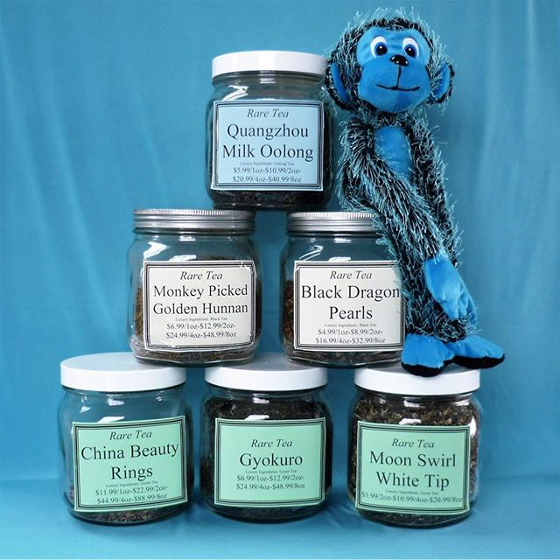

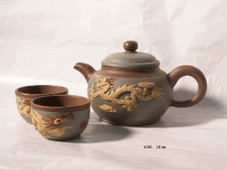
This is the continuation of the home page
Adress:
5872 Forbes Ave, Pittsburgh, PA 15217
Hours:
Monday 11AM–7PM to Saturday 11AM–7PM | Sunday 12–5PM
Give some commonly looked for information
Our Products
Coffee
Teas
Other Products
Clicking the image or the name or around it will bring you to the products page
@Blue Monkey Tea | Home | Careers | check out our old website!
Notes:
Continuation of homepage

Slide 3
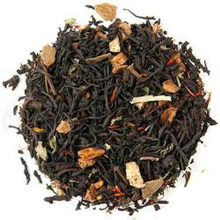
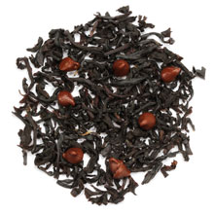
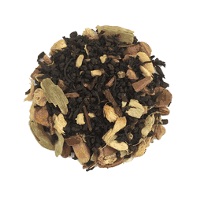
Home
Products
Store Information
Contact Us!
Tea Coffee Other Products
You can click on tea or coffee or other products and it will bring up different products.
Under the image will be the name of the product and price of it
Apple Spice Black Loose Tea
2oz Price: $4.50
8oz Price: $13.99
Black Dragon Pearls
2oz Price: $4.50
8oz Price: $13.99
Chocolate Tea, Loose Leaf Tea
2oz Price: $4.50
8oz Price: $13.99
Notes:
This would just be rows and columns of products and at the bottom there would be the same footer as the homepage

Slide 4
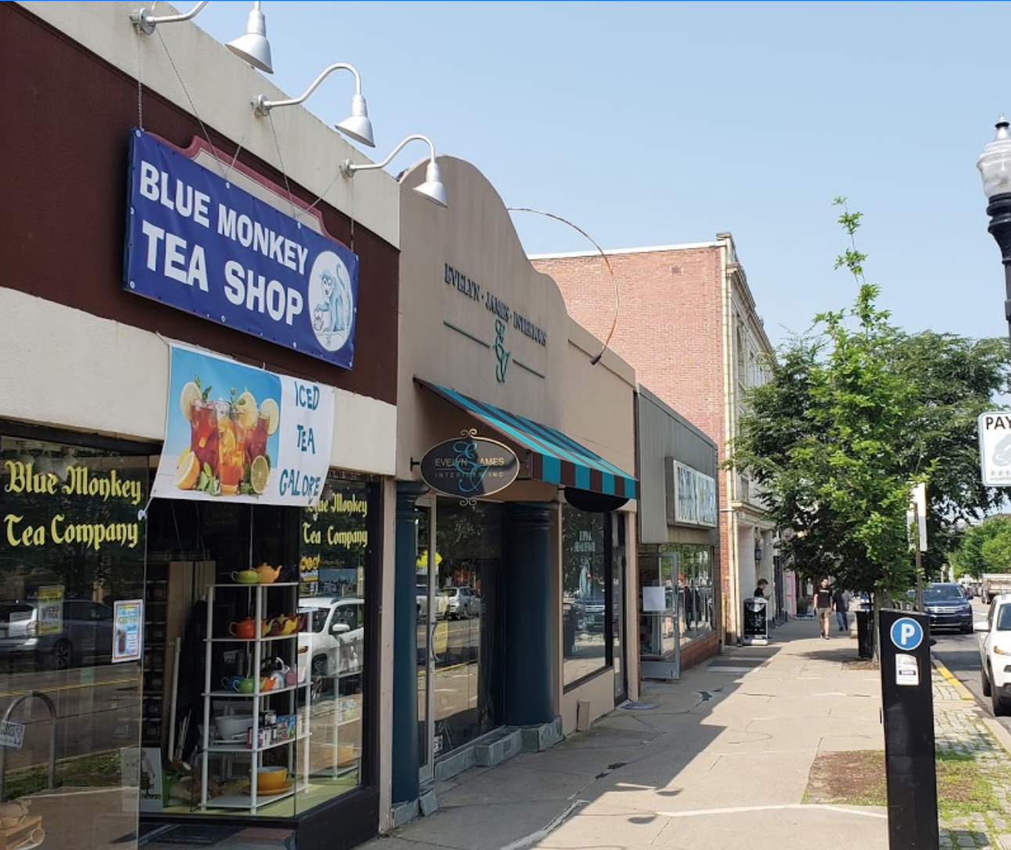
Home
Products
Store Information
Contact Us!
Store Information
The information at the top is to indicate that the other location is closed for the customers
Sorry but our Carnegie location is closed!
Either Map or Store image
Address | 5872 Forbes Ave, Pittsburgh, PA 15217
Hours | Monday 11AM–7PM to Saturday 11AM–7PM | Sunday 12–5PM
Email | (412) 422-1606
Phone Number | 100teacups@gmail.com
Table of information

Slide 5
You can click either tab to view the busy hours of either portion of the week
This is the continuation of the store information page
Monday to Saturday Sunday
The busy hours and how many customers there are per hours would be here
@Blue Monkey Tea | Home | Careers | check out our old website!
Notes:
Continuation of homepage

Slide 6
Home
Products
Store Information
Contact Us!
Name ___________________________
Email ___________________________
Address ___________________________
Phone Number
___________________________
Would you like to join our mailing list
Submit
Contact information for the customers, may add a few more fields later one
Submit button is clickable and will send the form to the email
And makes sure the input for phone number is a 10 digit number
@Blue Monkey Tea | Home | Careers | check out our old website!

Slide 7
NEXT - mobile high fidelity wireframes

Slide 8
logo
Welcome
View Our Products
Product image
We offer Tea Classes and Tea Tastings every month. We also carry over 30 types of coffee beans and some neat coffee makers!
Navigation bar at the bottom of the screen so it is easier to reach the buttons
Home Products Stores Contact

Slide 9
Two columns so the images can easily be seen, also also in alphabetical order for ease of finding products
logo
Teas Coffee
Image of tea
B tea
Price: $4.50
Image o
A tea
Price: $4.50
C tea
Price: $4.50
D tea
Price: $4.50
Image of tea
Image of tea
Home Products Stores Contact

Slide 10
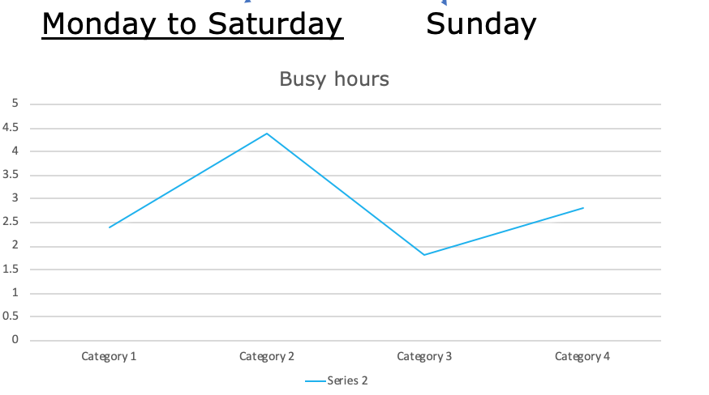
logo
Visit out location Below!
Image of the store
Embedded map taken out, only on home page so there is not too much on this page
Address:
5872 Forbes Ave, Pittsburgh, PA 15217
Hours:
Monday to Saturday 11AM–7PM | Sunday 12–5PM
Phone Number (412) 422-1606
Email : 100teacups@gmail.com
Graph With Busy Hours
Home Products Stores Contact

Slide 11
logo
Name
_____________________
Address
_____________________
Phone Number
_____________________
Email _____________________
Would you like to join our mailing list
A short form for the user to fill out to contact the shop or join mailing list
Submit
Home Products Stores Contact

